Slide 1

DYNAMIC PROGRAMMING
By
Dr. N. Subhash Chandra

Slide 2
Dynamic Programming: Control of abstraction
Dynamic programming is a name, coined by Richard Bellman in 1955.
An Algorithmic design method, that can be used ,when the solution to a problem can be viewed as the result of a sequence of decisions.
When optimal decision sequences contain optimal decision subsequences, we can establish recurrence equations, called dynamic-programming recurrence equations, that enable us to solve the problem in an efficient way.

Slide 3

Principle of Optimality concept
Dynamic programming is based on the principle of optimality ( coined by Bellman).
The principle implies that an optimal decision sequence is comprised of optimal decision subsequences.
Dynamic programming cannot be applied when this principle does not hold.

Slide 4
The steps in Dynamic programming solution are
Verify that the principle of optimality holds.
Set up the dynamic-programming recurrence equations.
Solve the dynamic-programming recurrence equations for the value of the optimal solution.
Perform a trace back step in which the solution itself is constructed.

Slide 5
Dynamic Programming
Used for optimization problems
A set of choices must be made to get an optimal solution
Find a solution with the optimal value (minimum or maximum)
There may be many solutions that lead to an optimal value
Our goal: find an optimal solution

Slide 6
Dynamic Programming Algorithm
Characterize the structure of an optimal solution
Recursively define the value of an optimal solution
Compute the value of an optimal solution in a bottom-up fashion
Construct an optimal solution from computed information (not always necessary)

Slide 7
Dynamic Programming Applications:
Multistage Graphs
Optima Binary Search Tree
Matrix Chain Multiplication
Reliability Design
0/1 Knapsack problem
Multiplicative Optimisation
Real world applications: Google maps shortest path,
Network data transfer from sender to receiver
All optimization problem
Routing, document distance measure

Slide 8
Dynamic Programming: Comparison
An algorithm design technique (like divide and conquer)
Divide and conquer
Partition the problem into independent subproblems
Solve the subproblems recursively
Combine the solutions to solve the original problem
Applicable when subproblems are not independent
A divide and conquer approach would repeatedly solve the common subproblems
Dynamic programming solves every subproblem just once and stores the answer in a table

Slide 9
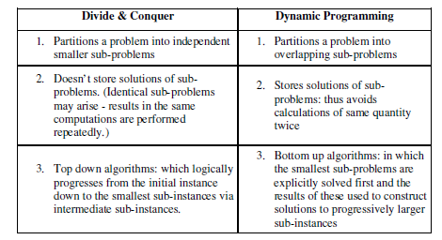

Slide 10
Multistage Graph: Dynamic method v.s. Greedy method
Comparison: In the greedy method, any decision is locally optimal.
These locally optimal solutions will finally add up to be a globally optimal solution.

Slide 11
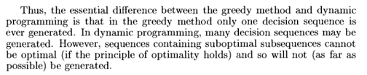
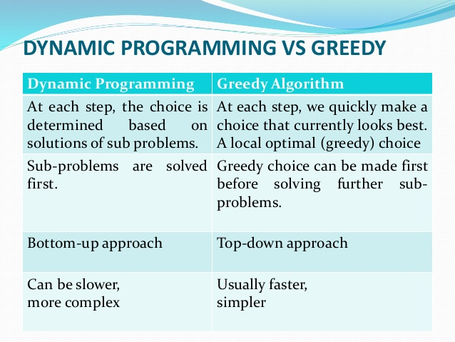

Slide 12
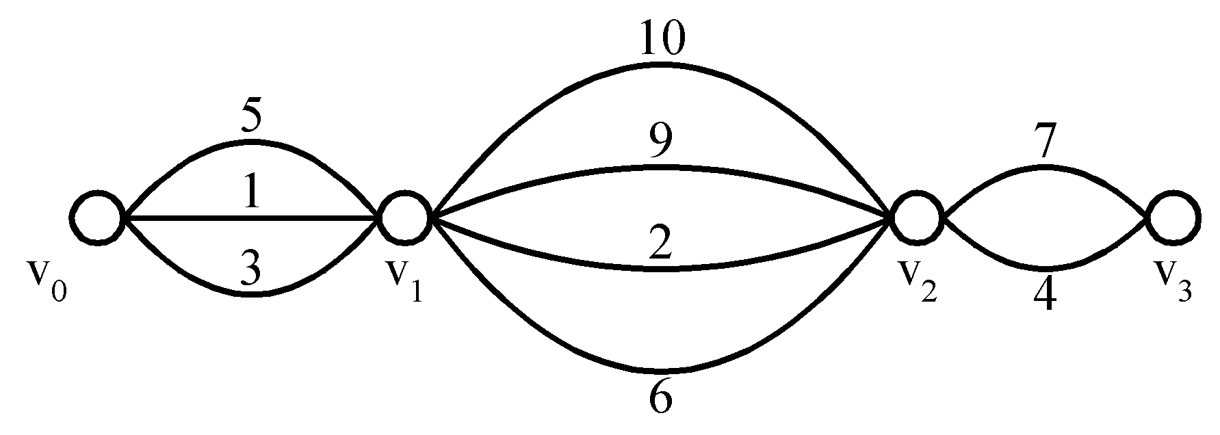
Multistage graph: The Greedy Method
E.g. Find a shortest path from v₀ to v₃.
The greedy method can solve this problem.
The shortest path: 1 + 2 + 4 = 7.

Slide 13
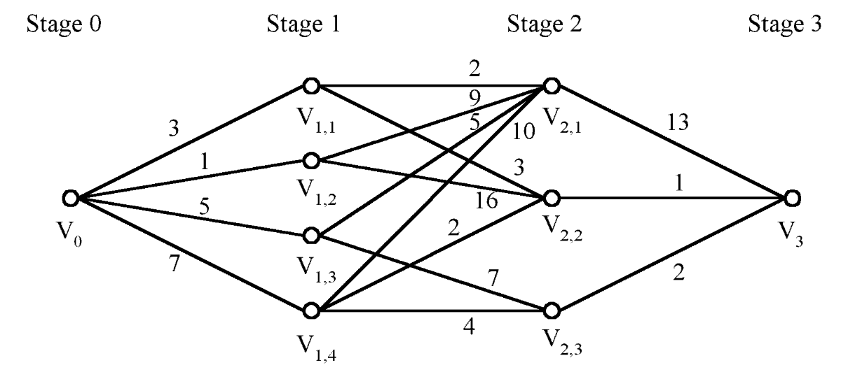
Multistage graph: The Greedy Method
E.g. Find a shortest path from v₀ to v₃ in the multi-stage graph.
Greedy method: v₀v_{1,2}v_{2,1}v₃ = 23
Optimal: v₀v_{1,1}v_{2,2}v₃ = 7
The greedy method does not work for this problem.
This is because decisions at different stages influence one another.

Slide 14
Multistage graph: The Greedy Method
E.g.
The greedy method cannot be applied to this case: S A D T 1+4+18 = 23.
The shortest path is: S C F T 5+2+2 = 9.

Slide 15
Multistage graph: Concept
A multistage graph G=(V,E) is a directed graph, weighted graph in which the vertices are partitioned into k>=2 disjoint sets Vi, i<=i<=k.
The vertex s is source and t is the sink. Let c(i,j) be the cost of edge
<i,j>.
The cost of a path from s to t is the sum of costs of the edges on the
path.
The multistage graph problem is to find a minimum-cost path from s to t.

Slide 16
Multistage graph: Problem
Let G=(v,E) be a directed graph. In this we divide the problem into no. of stages or multiple stages then we try to solve whole problem.
Multistage graph problem is to determine shortest path from source to destination. This can be solved by using either forward or backward approach.
Approaches:
Forward approach: we will find the path from destination to source,
Backward approach: we will find the path from source to destination.

Slide 17
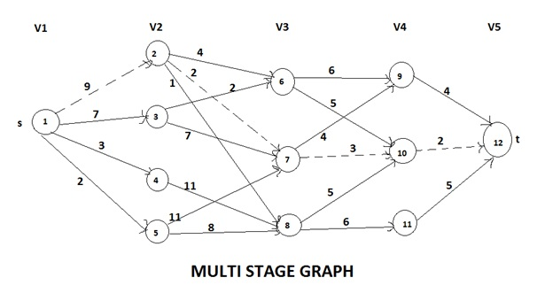
Multistage Graph: Dynamic programming

Slide 18
Multistage Graphs: Dynamic Programming
A dynamic programming formulation for a k-stage graph problem is obtained by first noticing that every s to t path is the result of a sequence of k-2 decisions.
The ith decision invloves determining which vertex in Vi+1, 1<=i<=k-2, is on the path. It is easy to see that principal of optimality holds.
Let p(i,j) be a minimum-cost path from vertex j in Vi to vertex t.
Let cost(i,j) be the cost of this path.
Using forward approach to find cost of the path
Cost(i,j) = min { c(j, l) + cost(i+1, l)} i-stage number
j-vertices available at particular stage
l∈Vi + 1
< j, l >∈E
l- vertices away from the vertex
■

Slide 19
Multistage Graphs: Backward Approach
The multistage graph problem can be solved using backward
approach.
Let bp(i,j) be a mimimum-cost path from vertex s to vertex j in V_{i} Let bcost(i,j) be cost of bp(i,j).
The backward apporach to find min. cost is
bcost(i,j) =
min { bcost(i-1, l ) +c( l,j)}
l∈Vi + 1
< j, l >∈E
Since bcost(2,j) = c(1,j) if <1,j> ∈ E and bcost(2,j) =∞
if <i,j> ∉ E, bcost(i,j) can be computed using above formula.

Slide 20












Multistage Graph: EXAMPLE 1:
Find the minimum cost path from s to t in the multistage graph of five stages shown below. Do this first using forward approach and then using backward approach.
2
4
6
2
2
6
9
4
9
1
5
7
3
7
4
7
10
2
12 t
s
1
3
3
2
4
11
5
8
11
5
11
6
5
8
FORWARD APPROACH:
We use the following equation to find the minimum cost path from s to t: cost (i, j) = min {c (j, l) + cost (i + 1, l)}
l ε Vi + 1

Slide 21
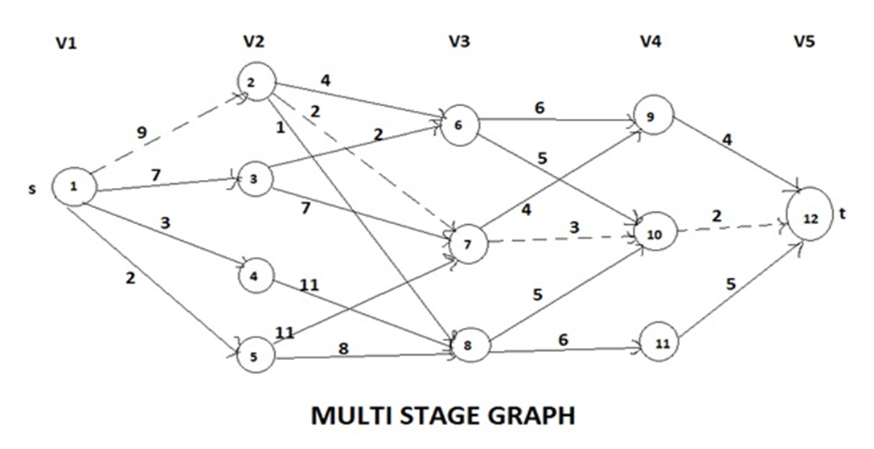
<j, l> ε E
cost (1, 1) = min {c (1, 2) + cost (2, 2), c (1, 3) + cost (2, 3), c (1, 4) + cost (2, 4),
c (1, 5) + cost (2, 5)}
= min {9 + cost (2, 2), 7 + cost (2, 3), 3 + cost (2, 4), 2 + cost (2, 5)}
Now first starting with,
cost (2, 2) = min{c (2, 6) + cost (3, 6), c (2, 7) + cost (3, 7), c (2, 8) + cost (3, 8)}
= min {4 + cost (3, 6), 2 + cost (3, 7), 1 + cost (3, 8)}
cost (3, 6) = min {c (6, 9) + cost (4, 9), c (6, 10) + cost (4, 10)}
= min {6 + cost (4, 9), 5 + cost (4, 10)}
cost (4, 9) = min {c (9, 12) + cost (5, 12)} = min {4 + 0) = 4
cost (4, 10) = min {c (10, 12) + cost (5, 12)} = 2
Therefore, cost (3, 6) = min {6 + 4, 5 + 2} = 7
cost (3, 7) = min {c (7, 9) + cost (4, 9) , c (7, 10) + cost (4, 10)}
= min {4 + cost (4, 9), 3 + cost (4, 10)}
cost (4, 9) = min {c (9, 12) + cost (5, 12)} = min {4 + 0} = 4
Cost (4, 10) = min {c (10, 2) + cost (5, 12)} = min {2 + 0} = 2

Slide 22
Therefore, cost (3, 7) = min {4 + 4, 3 + 2} = min {8, 5} = 5
cost (3, 8) = min {c (8, 10) + cost (4, 10), c (8, 11) + cost (4, 11)}
= min {5 + cost (4, 10), 6 + cost (4 + 11)}
cost (4, 11) = min {c (11, 12) + cost (5, 12)} = 5
Therefore, cost (3, 8) = min {5 + 2, 6 + 5} = min {7, 11} = 7
Therefore, cost (2, 2) = min {4 + 7, 2 + 5, 1 + 7} = min {11, 7, 8} = 7
Therefore, cost (2, 3) = min {c (3, 6) + cost (3, 6), c (3, 7) + cost (3, 7)}
= min {2 + cost (3, 6), 7 + cost (3, 7)}
= min {2 + 7, 7 + 5} = min {9, 12} = 9
cost (2, 4) = min {c (4, 8) + cost (3, 8)} = min {11 + 7} = 18
cost (2, 5) = min {c (5, 7) + cost (3, 7), c (5, 8) + cost (3, 8)}
= min {11 + 5, 8 + 7} = min {16, 15} = 15
Therefore, cost (1, 1) = min {9 + 7, 7 + 9, 3 + 18, 2 + 15}
= min {16, 16, 21, 17} = 16
The minimum cost path is 16.

Slide 23

The path is
1
2
7
10
12
or
6
1
3
10
12
BACKWARD APPROACH:
We use the following equation to find the minimum cost path from t to s: Bcost (i, J) = min {Bcost (i – 1, l) + c (l, J)}
l ε vi – 1
<l, j> ε E
Bcost (5, 12) = min {Bcost (4, 9) + c (9, 12), Bcost (4, 10) + c (10, 12),
Bcost (4, 11) + c (11, 12)}
= min {Bcost (4, 9) + 4, Bcost (4, 10) + 2, Bcost (4, 11) + 5}
Bcost (4, 9)
= min {Bcost (3, 6) + c (6, 9), Bcost (3, 7) + c (7, 9)}
= min {Bcost (3, 6) + 6, Bcost (3, 7) + 4}
Bcost (3, 6)
= min {Bcost (2, 2) + c (2, 6), Bcost (2, 3) + c (3, 6)}
= min {Bcost (2, 2) + 4, Bcost (2, 3) + 2}
Bcost (2, 2)
= min {Bcost (1, 1) + c (1, 2)} = min {0 + 9} = 9

Slide 24
Bcost (2, 3)
= min {Bcost (1, 1) + c (1, 3)} = min {0 + 7} = 7
Bcost (3, 6)
= min {9 + 4, 7 + 2} = min {13, 9} = 9
Bcost (3, 7)
= min {Bcost (2, 2) + c (2, 7), Bcost (2, 3) + c (3, 7),
Bcost (2, 5) + c (5, 7)}
Bcost (2, 5)
= min {Bcost (1, 1) + c (1, 5)} = 2
Bcost (3, 7)
= min {9 + 2, 7 + 7, 2 + 11} = min {11, 14, 13} = 11
Bcost (4, 9) = min {9 + 6, 11 + 4} = min {15, 15} = 15
Bcost (4, 10) = min {Bcost (3, 6) + c (6, 10), Bcost (3, 7) + c (7, 10),
Bcost (3, 8) + c (8, 10)}
Bcost (3, 8) = min {Bcost (2, 2) + c (2, 8), Bcost (2, 4) + c (4, 8),
Bcost (2, 5) + c (5, 8)}
Bcost (2, 4) = min {Bcost (1, 1) + c (1, 4)} = 3
Bcost (3, 8) = min {9 + 1, 3 + 11, 2 + 8} = min {10, 14, 10} = 10
Bcost (4, 10) = min {9 + 5, 11 + 3, 10 + 5} = min {14, 14, 15) = 14
Bcost (4, 11) = min {Bcost (3, 8) + c (8, 11)} = min {Bcost (3, 8) + 6}
= min {10 + 6} = 16
Bcost (5, 12) = min {15 + 4, 14 + 2, 16 + 5} = min {19, 16, 21} = 16.

Slide 25








Multistage Graph EXAMPLE 2:
Find the minimum cost path from s to t in the multistage graph of five stages shown below. Do this first using forward approach and then using backward approach.
3
4
1
2
4
7
7
5
6
3
6
s
1
5
2
9 t
2
5
3
3
6
8
8
6
2
SOLUTION:
FORWARD APPROACH:
cost (i, J) = min {c (j, l) + cost (i + 1, l)}
l ε Vi + 1
<J, l> ∈E
cost (1, 1) = min {c (1, 2) + cost (2, 2), c (1, 3) + cost (2, 3)}
= min {5 + cost (2, 2), 2 + cost (2, 3)}

Slide 26
cost (2, 2) = min {c (2, 4) + cost (3, 4), c (2, 6) + cost (3, 6)}
= min {3+ cost (3, 4), 3 + cost (3, 6)}
cost (3, 4) = min {c (4, 7) + cost (4, 7), c (4, 8) + cost (4, 8)}
= min {(1 + cost (4, 7), 4 + cost (4, 8)}
cost (4, 7) = min {c (7, 9) + cost (5, 9)} = min {7 + 0) = 7
cost (4, 8) = min {c (8, 9) + cost (5, 9)} = 3
Therefore, cost (3, 4) = min {8, 7} = 7
cost (3, 6) = min {c (6, 7) + cost (4, 7), c (6, 8) + cost (4, 8)}
= min {6 + cost (4, 7), 2 + cost (4, 8)} = min {6 + 7, 2 + 3} = 5
Therefore, cost (2, 2) = min {10, 8} = 8
cost (2, 3) = min {c (3, 4) + cost (3, 4), c (3, 5) + cost (3, 5), c (3, 6) + cost
(3,6)}
cost (3, 5) = min {c (5, 7) + cost (4, 7), c (5, 8) + cost (4, 8)}= min {6 + 7, 2 + 3}
= 5
Therefore, cost (2, 3) = min {13, 10, 13} = 10
cost (1, 1) = min {5 + 8, 2 + 10} = min {13, 12} = 12

Slide 27
BACKWARD APPROACH:
Bcost (i, J) = min {Bcost (i – 1, l) = c (l, J)}
l ∈ vi – 1
<l ,j>∈ E
Bcost (5, 9) = min {Bcost (4, 7) + c (7, 9), Bcost (4, 8) + c (8, 9)}
= min {Bcost (4, 7) + 7, Bcost (4, 8) + 3}
Bcost (4, 7) = min {Bcost (3, 4) + c (4, 7), Bcost (3, 5) + c (5, 7),
Bcost (3, 6) + c (6, 7)}
= min {Bcost (3, 4) + 1, Bcost (3, 5) + 6, Bcost (3, 6) + 6}
Bcost (3, 4) = min {Bcost (2, 2) + c (2, 4), Bcost (2, 3) + c (3, 4)}
= min {Bcost (2, 2) + 3, Bcost (2, 3) + 6}
Bcost (2, 2) = min {Bcost (1, 1) + c (1, 2)} = min {0 + 5} = 5
Bcost (2, 3) = min (Bcost (1, 1) + c (1, 3)} = min {0 + 2} = 2
Therefore, Bcost (3, 4) = min {5 + 3, 2 + 6} = min {8, 8} = 8
Bcost (3, 5) = min {Bcost (2, 3) + c (3, 5)} = min {2 + 5} = 7
Bcost (3, 6) = min {Bcost (2, 2) + c (2, 6), Bcost (2, 3) + c (3, 6)}
= min {5 + 5, 2 + 8} = 10
Therefore, Bcost (4, 7) = min {8 + 1, 7 + 6, 10 + 6} = 9
Bcost (4, 8) = min {Bcost (3, 4) + c (4, 8), Bcost (3, 5) + c (5, 8),
Bcost (3, 6) + c (6, 8)}
= min {8 + 4, 7 + 2, 10 + 2} = 9
Therefore, Bcost (5, 9) = min {9 + 7, 9 + 3} = 12

Slide 28
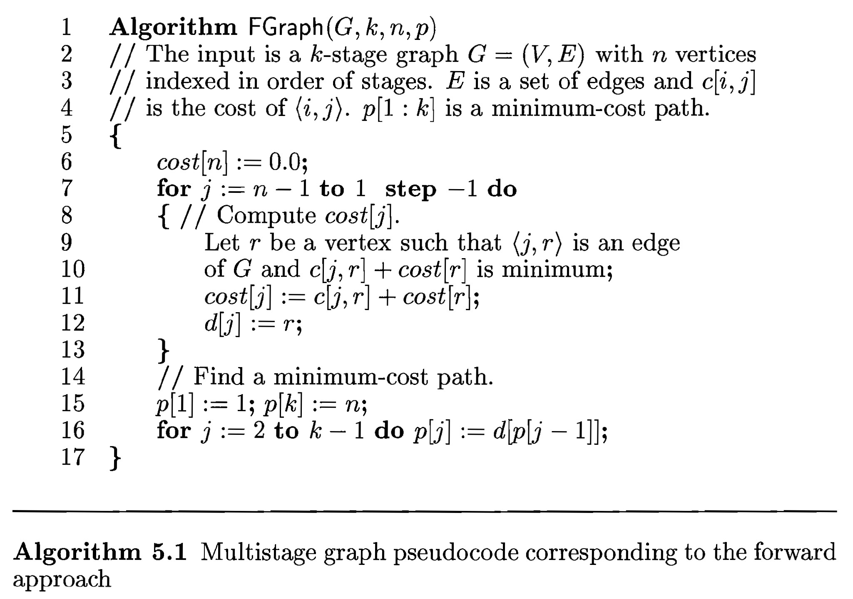
Multistage Graph : Forward Approach Algorithm

Slide 29
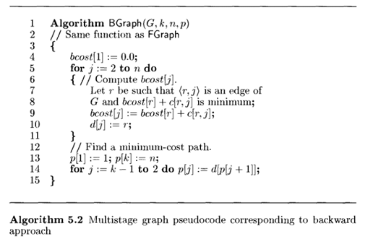
Multistage Graphs: Backward Approach Algorithm
// Compute Bcost [j].
Complexity Analysis:
The complexity analysis of the algorithm is fairly straightforward. Here, if G has ⎪E⎪
edges, then the time for the first for loop is Φ (⎪V⎪ +⎪E⎪).

Slide 30
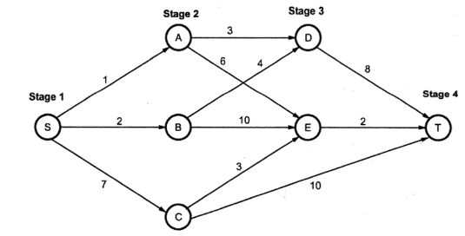
Multistage Graph: Exercise-1&2

